Slide 1
Working collaboratively with Git
James Whale, Data Engineer

Slide 2
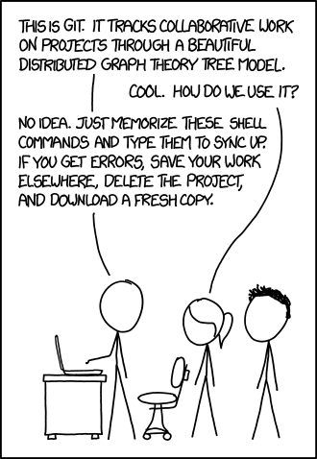
What is Git?

Slide 3
What are the problems of multiple developers working together on the same code?
How do two developers work on the same file at the same time?
How you control who can make changes?
How do we know who made changes and why?
How do we can make sure we can properly test our code before releasing a new version?

Slide 4
How does git allow us to work together?
Git can do the following that helps us do this:
Branching
Commit messages
Pull Requests

Slide 5
Branches!
What is branching?
How we use it at kobalt data team
Master branch
Develop branch
Feature branches
Release branches
Hotfix branches

Slide 6
Master branch
The master branch is the main branch of a project
The master branch is a permanent branch
It should represent the production state of the repository
Access to the master branch should be tightly controlled
Whenever changes are merged into the master this branch, this is a new production release

Slide 7
Develop branch
The develop branch is a permanent branch
It’s state should represent the latest delivered development ready for the next release
Sometime called the integration branch
When the develop branch is in a stable state and is ready for a new release, the develop branch will be merged into the master branch

Slide 8
Feature branches
A feature branch is a short lived branch used to develop a new feature
Feature branches will usually branch from the develop branch
Feature branches should always be merged back into the develop branch
Feature branches should only exist for the duration of the development of the new feature

Slide 9
Release branches
A release branch is used in preparation of a new production release
Release branches will usually branch from the develop branch
Release branches should always be merged back into the develop or master branches
Release branches allow for minor bugfixes and testing before a release
By doing this work on a release branch it frees up the develop branch for the development towards the next big release

Slide 10
Hotfix branches
A hotfix branch is similar to a release branch, except they are for unplanned changes such as a critical bug found in production code
hotfix branches will usually branch from the master branch
hotfix branches should always be merged back into the develop and master branches
This allows for the fix to be applied to the master branch without disrupting new work on the develop branch

Slide 11
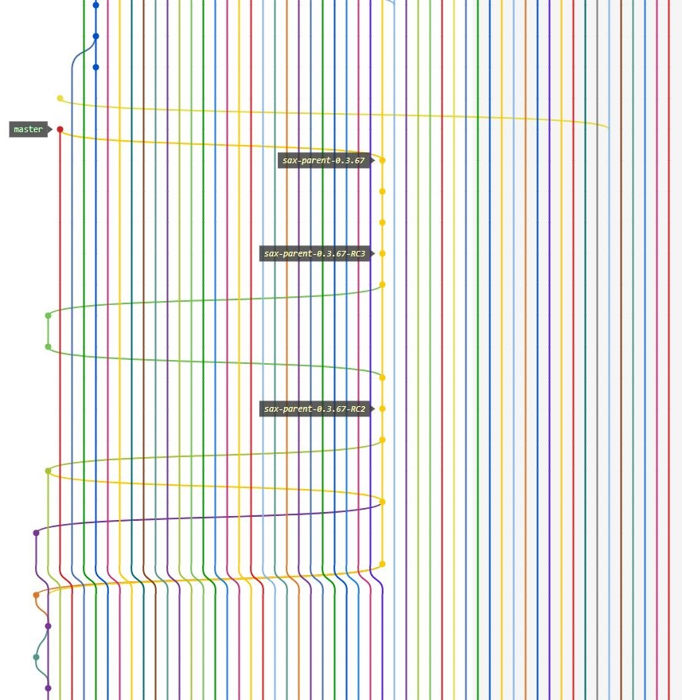

Slide 12
Commits
Once I’ve completed the feature
I want to commit my code
The commit is the code im going to change
So I add my code to the commit
Then I commit it
I write a commit message explaining what I changed and why
Once you have made a commit don’t forget to push it to the remote repository
this is when you upload your code to the your github repository

Slide 13
Useful Commit tips
Commit messages should be meaningful
Eg Something good
Not something Kedar wrote
Think about future you, could somone (probably you in 6 months time) understand why you made the change
This is you signing your signature on your code
Also do you want to be ‘that person, why did they do that!!’

Slide 14
The dreaded merge conflict
Oh no I got a merge conflict!
What is it?
Explain why its happened
How do I fix it
2 developers working on the same file both adding a new method to the bottom of a file
How does git know what to do?
On your branch, pull the other develpers changes from the remote repo
This will mix their code to yours – so this can look really messy and confusing
Manually fix the conflict by choosing the right code
Don’t forget to then commit and push your commit again

Slide 15
Pull Requests
Check the code does what it should
Discuss if this is the right solution/approach as a team
Pull requests are not personal! We’re all trying to make code that we are all proud of
The whole team is on everyone’s pull requests
Everyone can make comments no matter how junior or senior you are
Make sure you check the ticket before you create your PR
When reviewing PRs be constructive! And helpful
Pull requests are either approved or rejected (meaning they need more work)
Once approved they can be merged into the target branch
This is when you might get a merge conflict
Then pub!

Slide 16
Questions?

Slide 17
Workshop
Go to https://github.com/jameswhale/git-introduction/
Work through meetup-git-workshop.md
Ask myself or Alison questions about it or anything else

